Slide 1
Object Oriented Programming with Grace and Kernan
Object Cache and Reflection

Slide 2
Kernan grace interpreter
Written by Michael Homer:
https://github.com/mwh
https://michael.homer.nz/
C# lexer, translation, execution
REPL loop w/ OK tab completion
Lineups, Exceptions, strings, numbers, types, dialects, import
Some static checking
No collections

Slide 3
Object Cache
Serialize translated objects, store in cache, de-serialize on load.
Easy with C#, just mark AST nodes as [Serializable], read and write through cache.
Isolate and ignore serialization errors, preserve other.
static ObjectCache
Get(filename) -> Node
Parse(filename) -> ParseNode
Translate(filename) -> Node
Serialize,deserialize

Slide 4
Sizes of binary objects

Slide 5
Dead End (for now)
Need multiple orders of magnitude improvement
AST Nodes linked to tokens, linked to parsers

Slide 6
Reflection
https://github.com/gracelang/minigrace/blob/master/stubs/mirrors.grace
http://bracha.org/mirrors.pdf

Slide 7
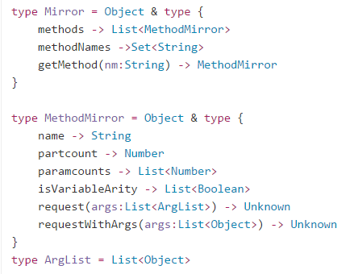
Reflection

Slide 8
Summary
Lots of TODOs on Kernan

